Slide 1
Risma Rustiyan R rismarustiyan@gmail.com
Software Development Model
V-Model
Information System Department
Faculty of Science and Technology
State Islamic University of Sulthan Syarif Kasim Riau
(UIN SUSKA RIAU)
https://sif.uin-suska.ac.id
http://uin-suska.ac.id

Slide 2
Agenda
Introduction
Definition
V-model figure
Four Test Level
The Differences between V-Model and Waterfall Model

Slide 3
V-Model
Introduction:
The V-model was developed to address some of the problems experienced using the traditional waterfall approach. Defects were being found too late in the life cycle, as testing was not involved until the end of the project.Testing also added lead time due to its late involvement.

Slide 4
Definition
The V-model is a model that illustrates how testing activities (verification and validation) can be integrated into each phase of the life cycle.

Slide 5
Definition (Cont.)
Within the V-model, validation testing takes place especially during the early stages, e.g. reviewing the user requirements, and late in the life cycle, e.g.during user acceptance testing

Slide 6
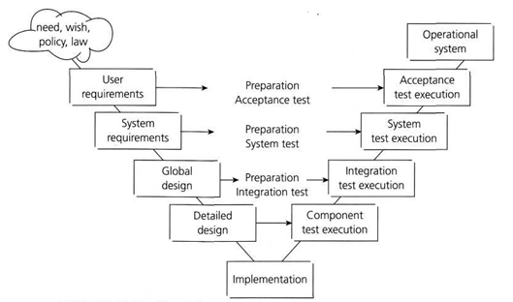
V-Model Figure
(Graham et al, 2011)

Slide 7
Four Test Level
The four test levels used, each with their own objectives,are:
component testing: searches for defects in and verifies the functioning of software components (e.g. modules, programs, objects, classes etc.) that are separately testable;
integration testing: tests interfaces between components, interactions to different parts of a system such as an operating system, file system and hardware or interfaces between systems;
system testing: concerned with the behavior of the whole system/product asdefined by the scope of a development project or product. The main focus ofsystem testing is verification against specified requirements;
acceptance testing: validation testing with respect to user needs, requirements, and business processes conducted to determine whether or not to accept the system.

Slide 8
V-Model VS Waterfall Model
The waterfall model was one of the earliest models to be designed. It has a natural timeline where tasks are executed in a sequential fashion. We start at the top of the waterfall with a feasibility study and flow down through the various project tasks finishing with implementation into the live environment.

Slide 9
V-Model Vs Waterfall Model (Cont.)
Design flows through into development, which in turn flows into build, and finally on into test. Testing tends to happen towards the end of the project life cycle so defects are detected close to the live implementation date. With this model it has been difficult to get feedback passed backwards up the waterfall and there are difficulties if we need to carry out numerous iterations for a particular phase.

Slide 10
Reference
Graham, Dorothy, et al. “Foundation of Software Testing ISTQB Certification”. Chapter 1 Fundamentals of Testing. 2011

